Slide 1
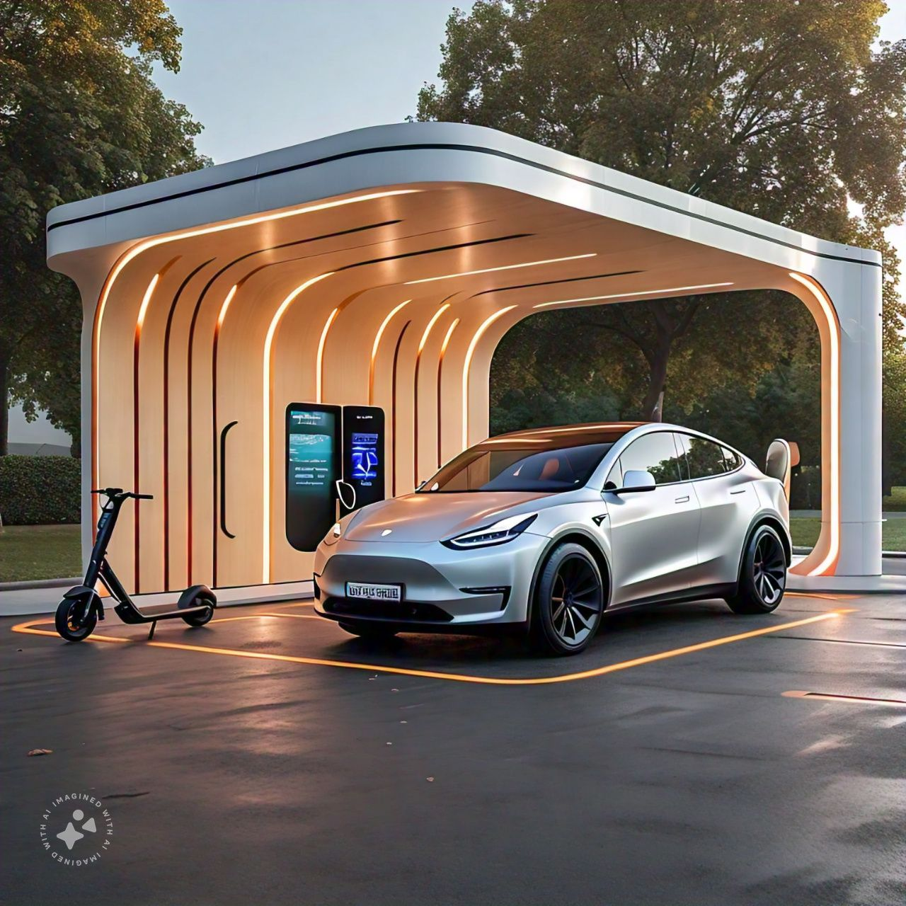
RESUME Challenge #12
Provide Insights for EV Launch in India

Slide 2
Insights For Automotive Company on EV Launch In India
Objective
AtliQ Motors is an automotive giant from the USA specializing in electric vehicles (EV). In the last 5 years, their market share rose to 25% in electric and hybrid vehicles segment in North America. As a part of their expansion plans, they wanted to launch their bestselling models in India where their market share is less than 2%. Bruce Haryali, the chief of AtliQ Motors India wanted to do a detailed market study of existing EV/Hybrid market in India before proceeding further. Bruce gave this task to the data analytics team of AtliQ motors and Peter Pandey is the data analyst working in this team.
Imagining yourself as Peter Pandey Perform the given tasks
Answer the given questions
Designing a Dashboard
Provide Recommendations and Insights

Slide 3
Dashboard

Slide 4
Primary Questions
List the top 3 and bottom 3 makers for the fiscal years 2023 and 2024 in terms of the number of 2-wheelers sold.
Top 3
Bottom 3
Years (date) | maker | Total 2-Wheeler EV’s Sold
2023 | OLA ELECTRIC | 271925
 | TVS | 165030
 | ATHER | 103812
 | BAJAJ | 74964
2024 | OLA ELECTRIC | 110872
 | TVS | 55742
 | BAJAJ | 40072
 | ATHER | 35213
Grand Total |  | 857630
Year | maker | Total EV's Sold
2023 | JITENDRA | 1180
 | BEING | 1354
 | PURE EV | 1789
2024 | HERO ELECTRIC | 1052
 | BATTRE ELECTRIC | 1128
 | REVOLT | 1582
Grand Total |  | 8085

Slide 5
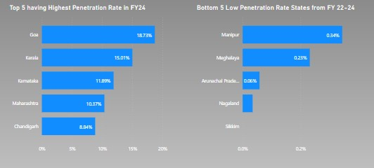
2)Identify the top 5 states with the highest penetration rate in 2-wheeler and 4 wheeler EV sales in FY 2024. 3) List the states with negative penetration (decline) in EV sales from 2022 to 2024?

Slide 6
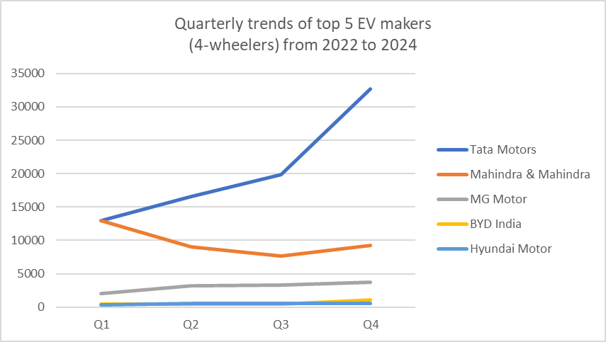
4) What are the quarterly trends based on sales volume for the top 5 EV makers (4-wheelers) from 2022 to 2024?
Makers | Total 4 Wheelers sold
Tata Motors | 82061
Mahindra & Mahindra | 38804
MG Motor | 12259
BYD India | 2418
Hyundai Motor | 1992

Slide 7
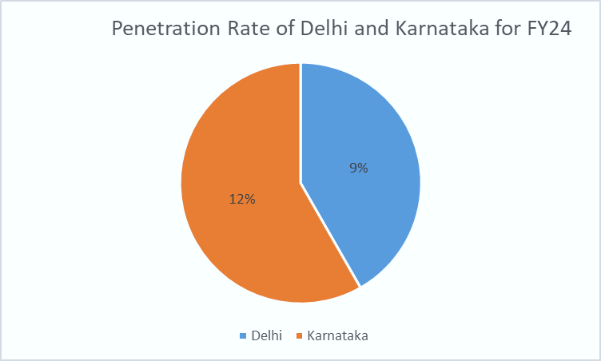
5)How do the EV sales and penetration rates in Delhi compare to Karnataka for 2024?

Slide 8
6) List down the compounded annual growth rate (CAGR) in 4-wheeler units for the top 5 makers from 2022 to 2024
maker | End Year | CAGR
BYD India | 2024 | 0.06730374
Hyundai Motor | 2024 | -0.088962209
Mahindra & Mahindra | 2024 | -0.390229053
MG Motor | 2024 | 0.018185791
Tata Motors | 2024 | -0.10666702

Slide 9
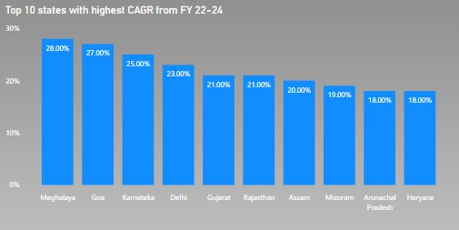
7) List down the top 10 states that had the highest compounded annual growth rate (CAGR) from 2022 to 2024 in total vehicles sold.

Slide 10
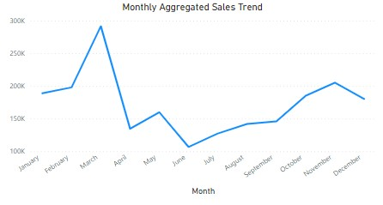
9) What are the peak and low season months for EV sales based on the data from 2022 to 2024?

Slide 11
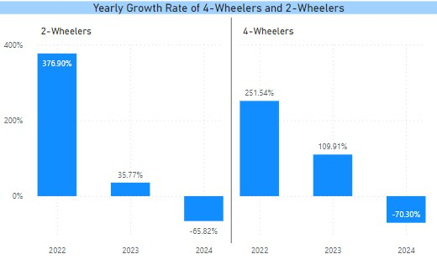
Estimate the revenue growth rate of 4-wheeler and 2-wheelers EVs in India for 2022 vs 2024 and 2023 vs 2024, assuming an average unit price.

Slide 12
Secondary Research Questions

Slide 13
1.What are the primary reasons for customers choosing 4-wheeler EVs in 2023 and 2024 (cost savings, environmental concerns, government incentives)?
Cost Savings :Overall Maintenance of an EV is comparatively very lower than gas powered vehicles , Gas powered vehicles need maintenance in different level Purchase price sometimes gets higher than gas powered vehicles Governments have introduced several schemes so as to give cost savings to the EV Buyers and promote the adoption of EVs
Environmental Concerns: EVs don't emit pollutants like gas-powered cars do, and all-electric vehicles produce zero tailpipe emissions. This can help reduce air pollution and environmental concerns. Moreover no energy is wasted whereas in gas powered vehicles only 12% of the gas is used for the energy remaining are the waste products generated during the combustion

Slide 14
Government Incentives : The Govt of India Introduced FAME (Faster Adoption and Manufacturing of Hybrid and Electric Vehicles) scheme in 2015 with the aim of promoting electric vehicles in the country. The scheme offers incentives for both manufacturers and buyers of electric vehicles. A budget of Rs 10,000 crore was allocated for the April 2019 introduction of the FAME II initiative. The goal was to encourage wider EV usage in India. The FAME-II plan was extended by the Indian government till March 31, 2024.
Each States Also offers EV incentives apart from the FAME scheme and each of the differ from state to state
Based on the data and cross referencing it with the incentives and amenities provided by the government for supporting EV growth we can say that these factors definitely play a crucial role in the decision making of a EV Buyer

Slide 15
2.How do government incentives and subsidies impact the adoption rates of 2-wheelers and 4-wheelers? Which states in India provided most subsidies?
Government incentives and subsidies impact the adoption rates of 2-wheelers and 4-wheelers for most of the states like Gujarat Maharashtra Rajasthan has good adoption rate and the government also offers good subsidies to promote EV adoption but its not true in all cases the state of Meghalaya also gives very good incentives but the adoption rate for EV’s is less than 1% and Kerala where the government give only a few benefits but still the adoption rate is close to 9% Yes for some states combined with other factors government incentives influence adoption rates
As of August 2024, some states in India offer subsidies for electric vehicles (EVs) in the form of cash subsidies, tax exemptions, and other incentives:
Gujarat
Offers a subsidy of up to ₹20,000 for electric two-wheelers, ₹50,000 for three-wheelers, and ₹1.5 lakhs for cars, with no registration charges. Gujarat also offers a subsidy of ₹10 lakh for setting up charging stations.
Maharashtra
Offers a subsidy of up to ₹25,000 for electric two-wheelers, ₹30,000 for electric three-wheelers, and ₹2.5 lakhs for electric four-wheelers, with no registration charges or road taxes.
Rajasthan
Offers a subsidy of ₹5,000 per kWh for vehicles with a maximum battery capacity of 2 kWh, ₹7,000 for 2–4 kWh, ₹9,000 for 4–5 kWh models, and ₹10,000 for models with a capacity of more than 5 kWh. Rajasthan also offers a waiver of road tax and registration fees, and reimbursement of SGST until March 2022.
Other states that offer EV subsidies include: Assam, Kerala, and Odisha.
Most states also exempt road tax for electric four-wheelers, with the exception of Kerala, Gujarat, and Uttar Pradesh. In Kerala and Gujarat, buyers must pay 50% of the road tax, and in Uttar Pradesh, buyers must pay 70%.

Slide 16
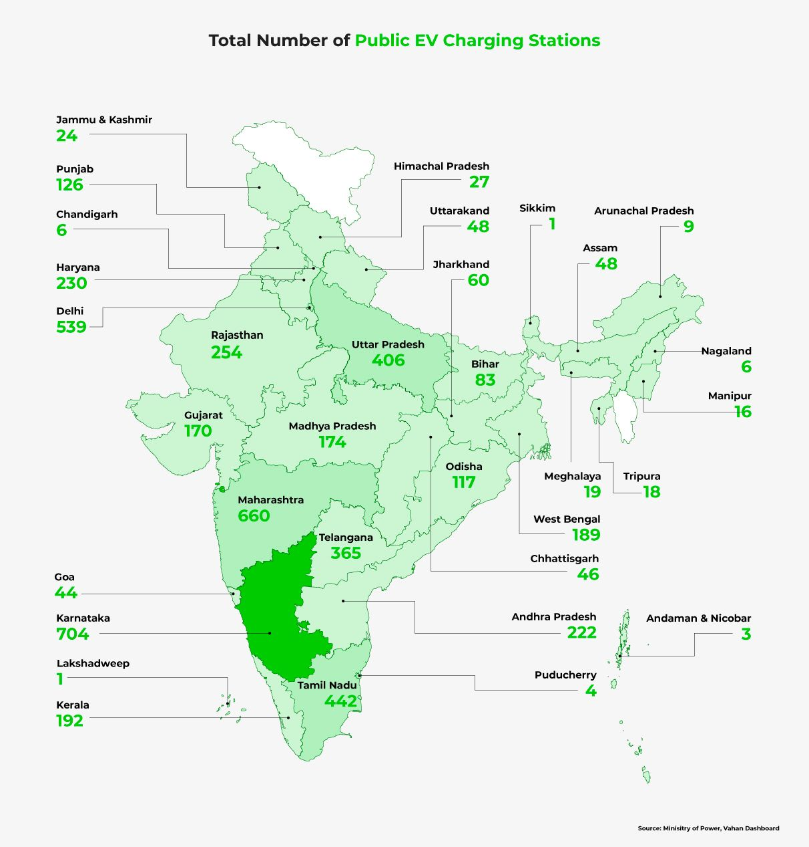
3.How does the availability of charging stations infrastructure correlate with the EV sales and penetration rates in the top 5 states?
Goa , Kerala ,Karnataka ,Maharashtra among the states having highest penetration and have a moderate charging station infrastructures .There are many factors influencing the growth of charging station and the barriers faced are very significant for example inadequate power grid by the states are demotivating the EV adoption
Method to overcome such a barrier is to first promote the use of renewable energy like wind and Solar then this will automatically result in higher EV adoption

Slide 17
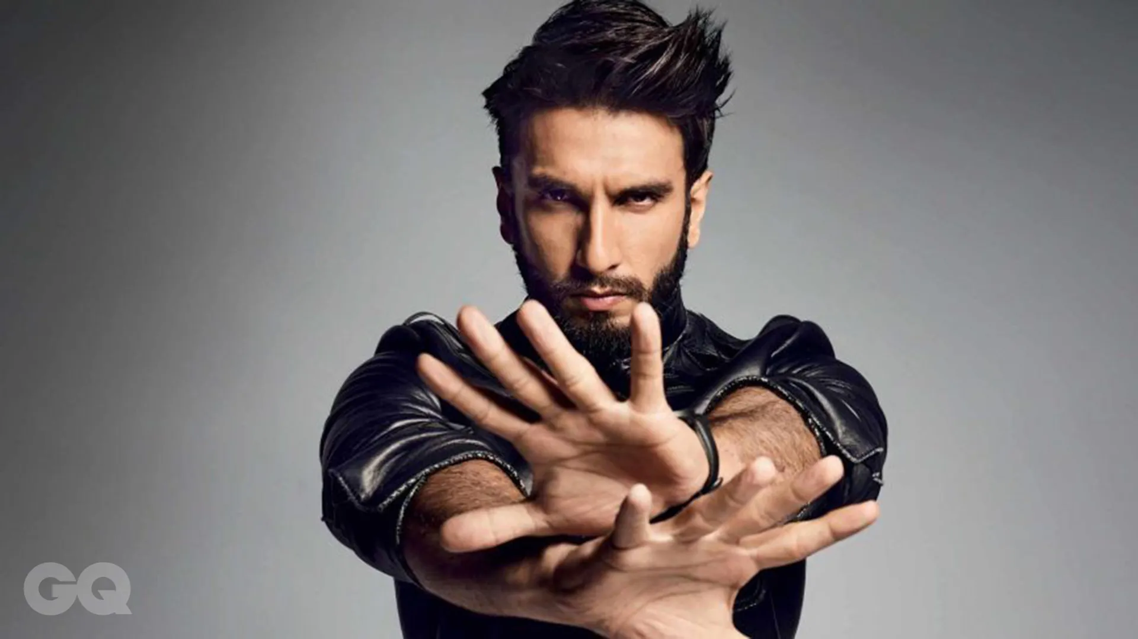
4.Who should be the brand ambassador if AtliQ Motors launches their EV/Hybrid vehicles in India and why?
Ranveer Singh : Represent New Gen and Entertainment
Ranveer Singh, with his charismatic persona and infectious energy, has become the undisputed king of brands, and can be the new face of EV’s

Slide 18
5.Which state of India is ideal to start the manufacturing unit? (Based on subsidies provided, ease of doing business, stability in governance etc.)
Karnataka :Besides the central government’s FAME subsidy, Karnataka does not offer any direct incentives to electric vehicle buyers. But that doesn’t make Karnataka less significant than other states in this list. That’s because Karnataka’s EV policy offers subsidies and concessions to EV makers (components, battery, charging enterprise).
Recently Tesla announced that it would set up a manufacturing plant in Karnataka. It reflects the contribution of Karnataka to India’s push for electric mobility. Apart from that, Karnataka has also waived road tax and registration charges for battery-powered vehicles.

Slide 19
6. Top 3 recommendations for AtliQ Motors.
Focusing on states that are already ahead in the adoption of renewable sources for electricity production ex: Rajasthan ,Gujarat ,Karnataka ,Tamil Nadu ,Maharashtra
Conduct Events to promote EV vehicles ex: Track Race ,Auto Show etc.
Sustainability Programs and Events
Promote the production of Batteries within India and Recycling of the dead batteries
Increase Public Charging Infrastructure (Renewable)
Develop Fast Charging Technology

Slide 20
THANK YOU

